Slide 1
Bank Loan Analytics
PGP-DSE JAN’25 Chennai – Group 2
Domain: Banking and Finance
Project done by Dhivya Balaje, Feroze Ahmed J, Deepak K, Santhosh G, Adlin Raja D

Slide 2
Problem Statement
We are presented with data from a bank based in the US. The bank would like to develop a classification system to classify loans into ‘Good’ or ‘Bad’ based on the potential borrower’s loan details and demographic.
This dataset, sourced from Kaggle, contains structured information on personal loan applicants including financial, employment, and loan-related attributes.
Our target column is a column called ‘Good vs Bad Loan’ which is the bank’s assessment of whether the loan given out to a particular customer turned out to be a Good loan (paid in full) or Bad loan (defaulted with minimal payment made).

Slide 3
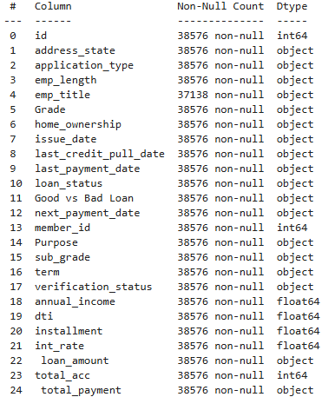
Understanding the Data
Number of rows: 38576
Number of columns: 25
Number of numerical columns: 7
Number of categorical columns: 18
Target: Good vs Bad Loan (Binary – Good Loan/Bad Loan)
Null value: Present only in the ‘emp_title’ column
Presence of outliers in numerical data: Yes
No duplicated rows present in the data

Slide 4
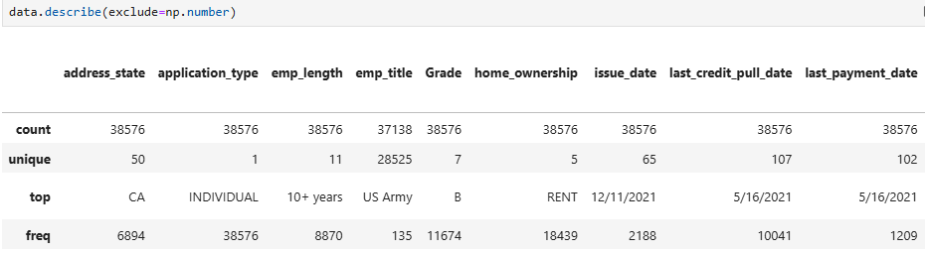
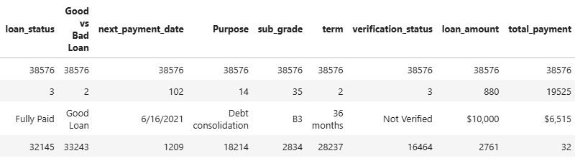
Data Cleaning – Categorical Columns

Slide 5
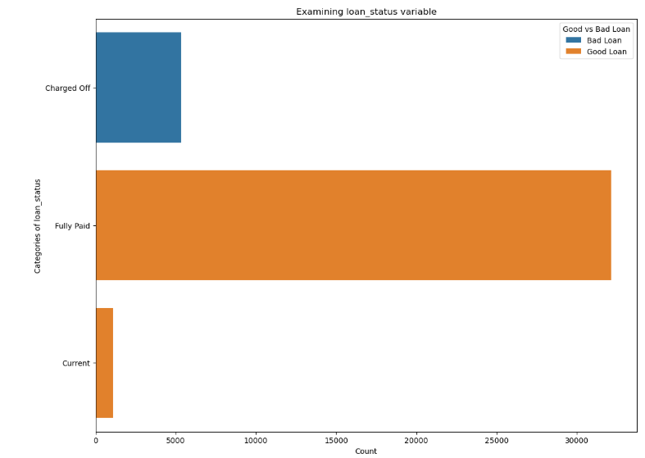
Data Cleaning – Categorical Columns
When examining the ‘loan_status’ column with the target column, we observed that all the ‘Charged off’ loans were Bad Loans and the rest were considered Good Loans.
This inference is an obvious one, and furthermore, we weren’t interested in including a variable linked to post-processing of a loan, so we decided to drop this column.

Slide 6
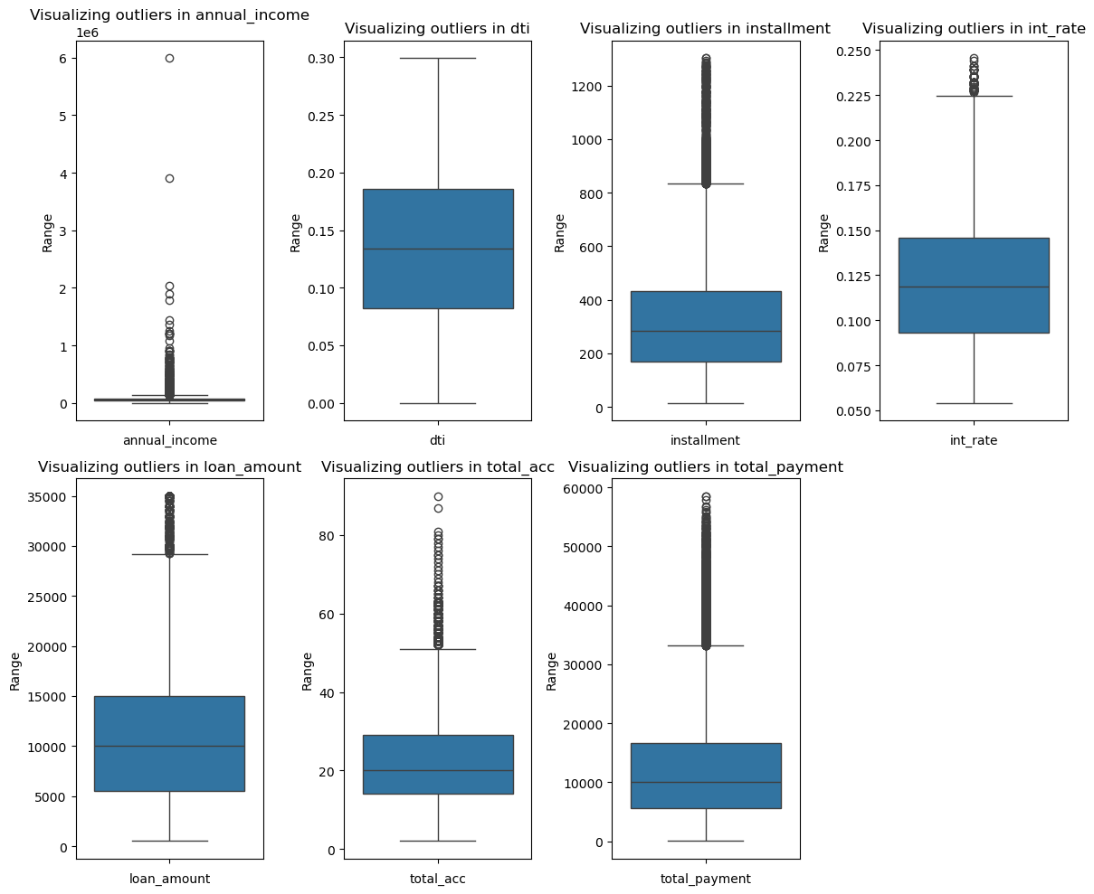
Data Cleaning – Numerical Columns

Slide 7
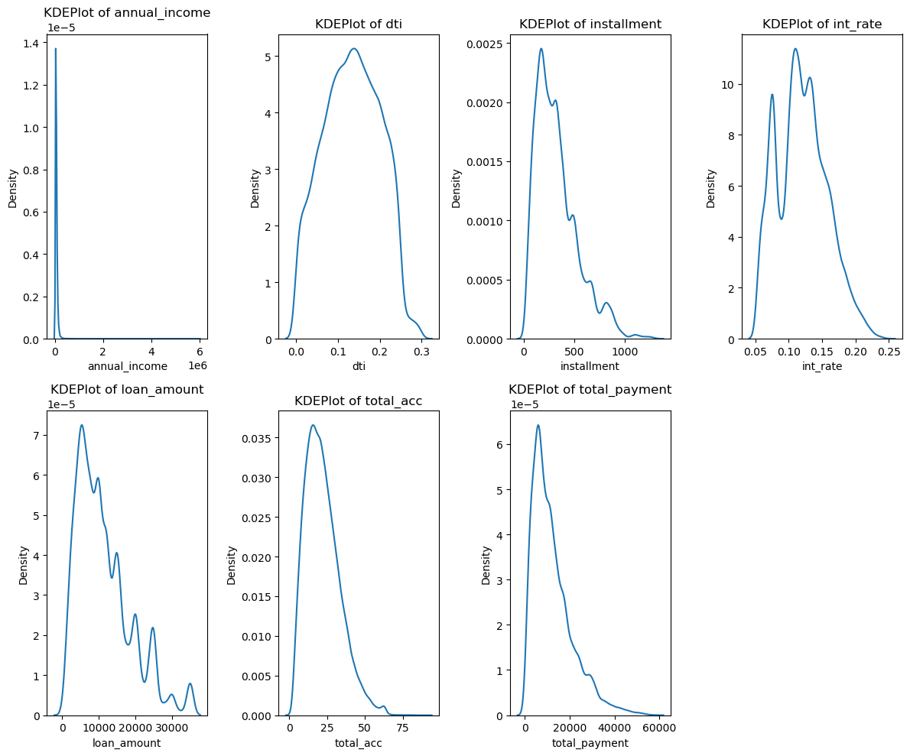
Data Cleaning – Skewness of Numerical Columns

Slide 8
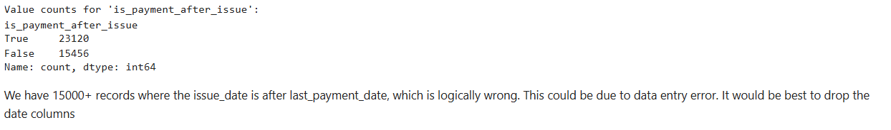
Data Cleaning – Date Columns
The four date columns in this dataset:
issue_date
last_payment_date
last_credit_pull_date
next_payment_date
The ranges of these dates were mostly within the year 2021, with some columns having minimal dates from 2022 (next payment and last credit pull)
We considered these columns pivotal for some feature engineering but we found something while checking the validity of the dates

Slide 9
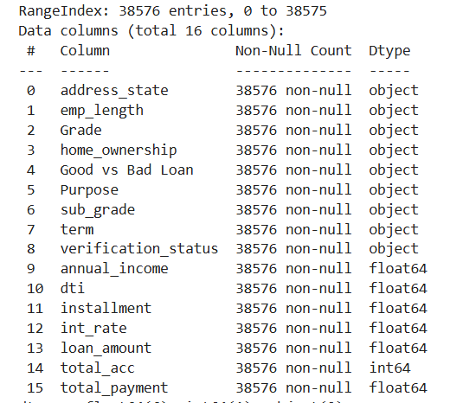
Original Dataset
Dataset after cleaning

Slide 10
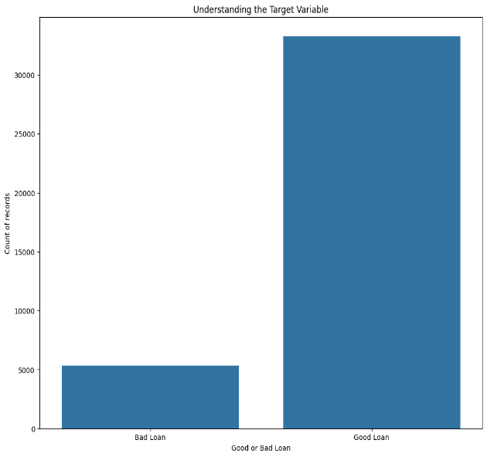

Target Variable – Good vs Bad Loan
Our target variable has class imbalance.
Techniques like SMOTE can be used to balance cases like this, but we proceeded without treating the class imbalance.

Slide 11
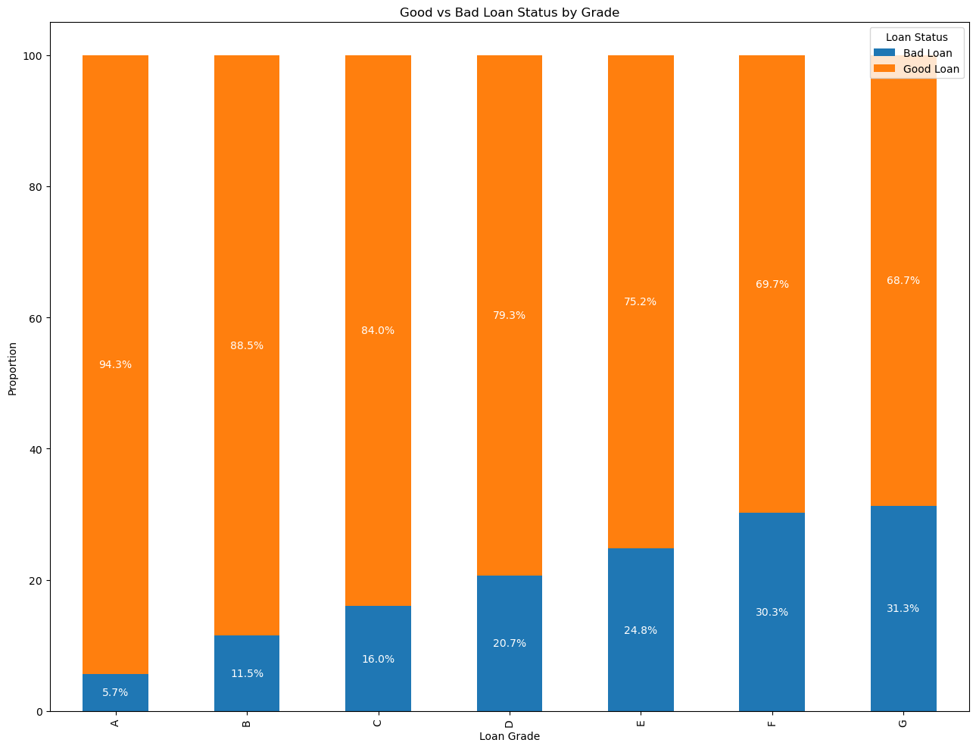
Exploratory Data Analysis
Key insights from our analysis
We can see that as the grade of the loan increases from A to G, there is a higher proportion of ‘Bad Loans’
Grade of the loan may be different due to several factors

Slide 12
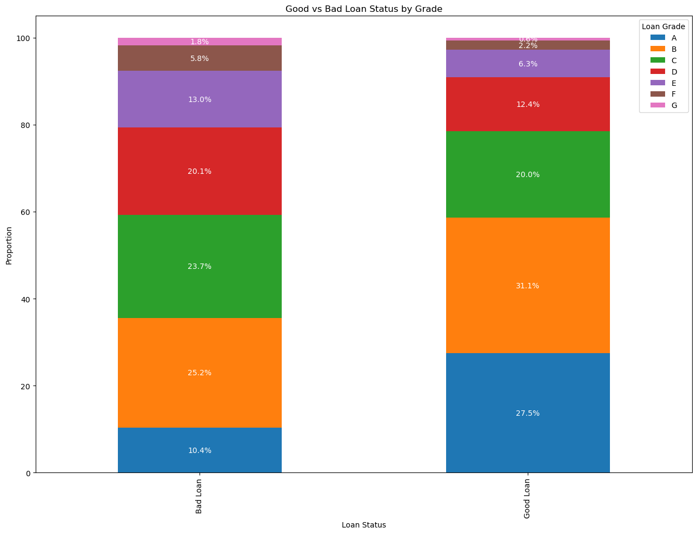

Slide 13
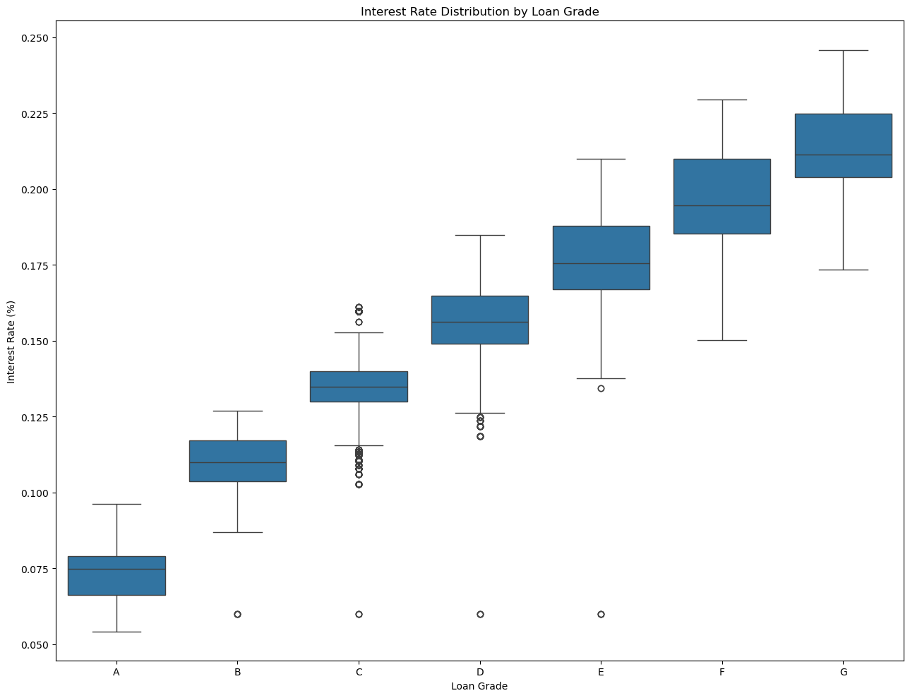
As the Grade of the loan changes, the thresholds for interest rates on the loans also change.
Higher interest rates may be a factor in a loan eventually becoming a ‘Bad Loan’

Slide 14
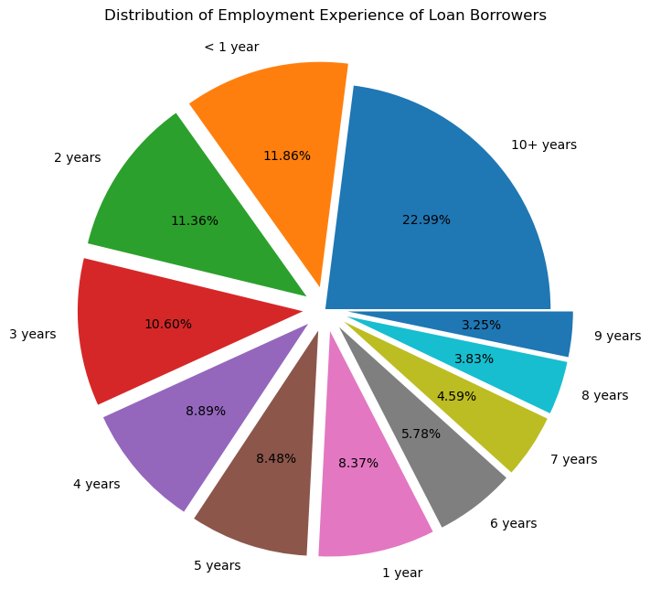

Slide 15
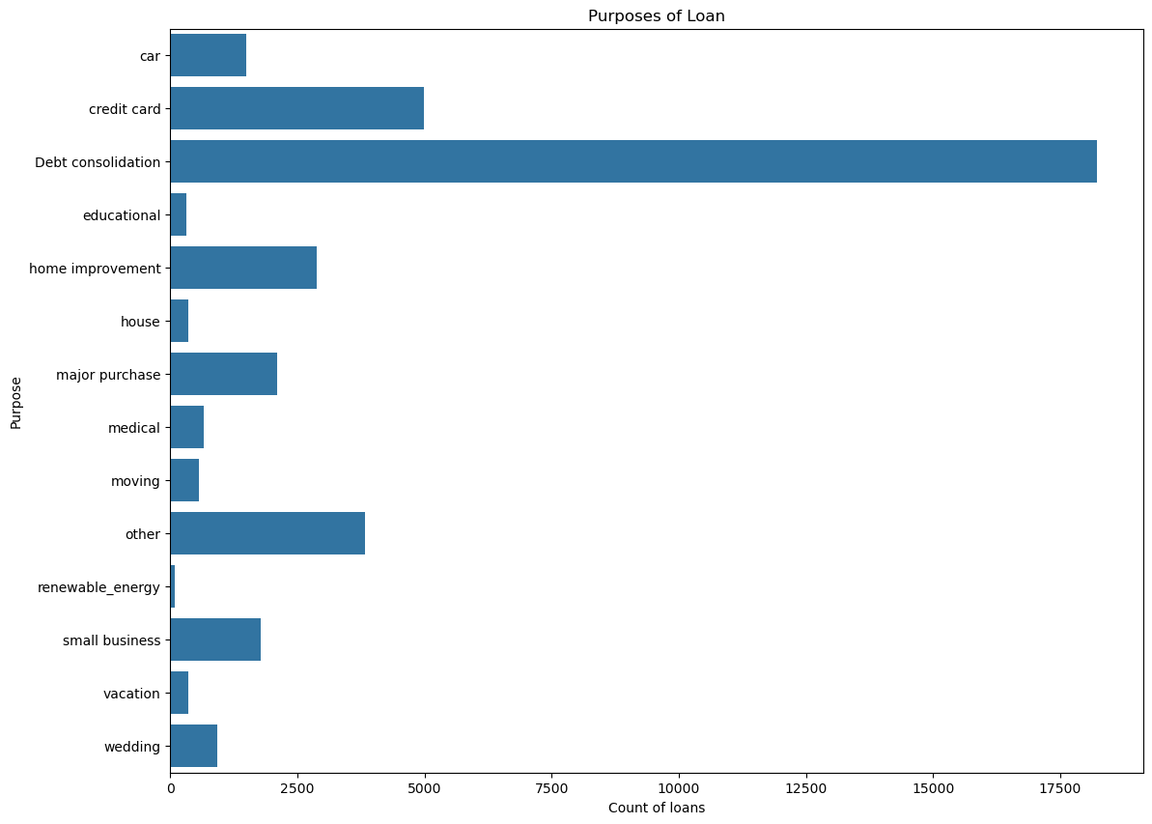

Slide 16
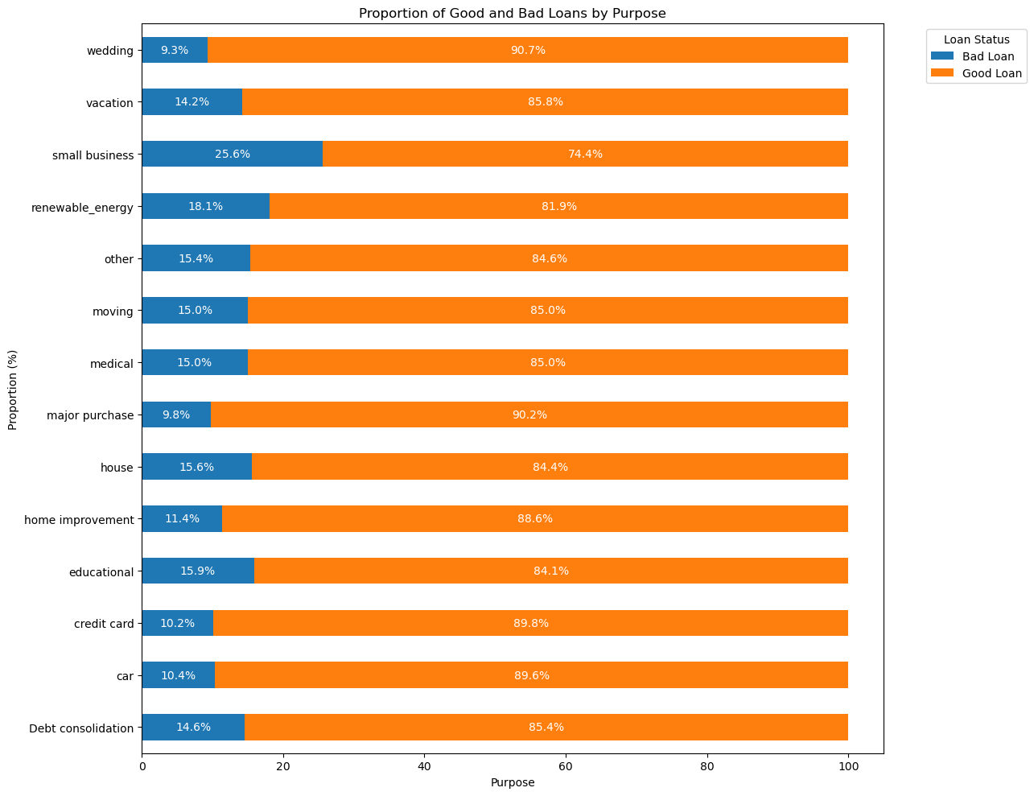

Slide 17
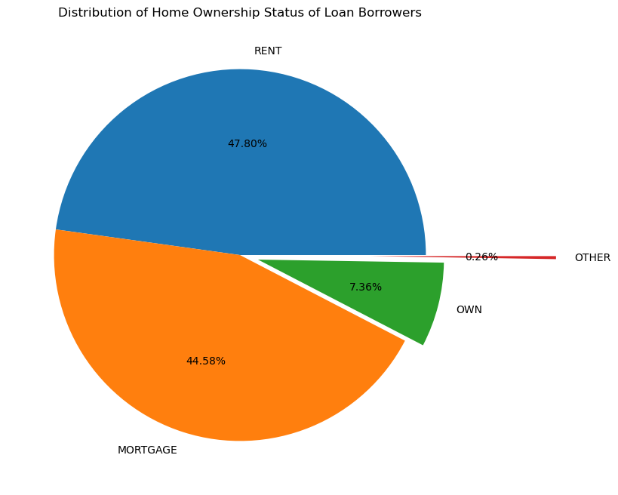

Slide 18
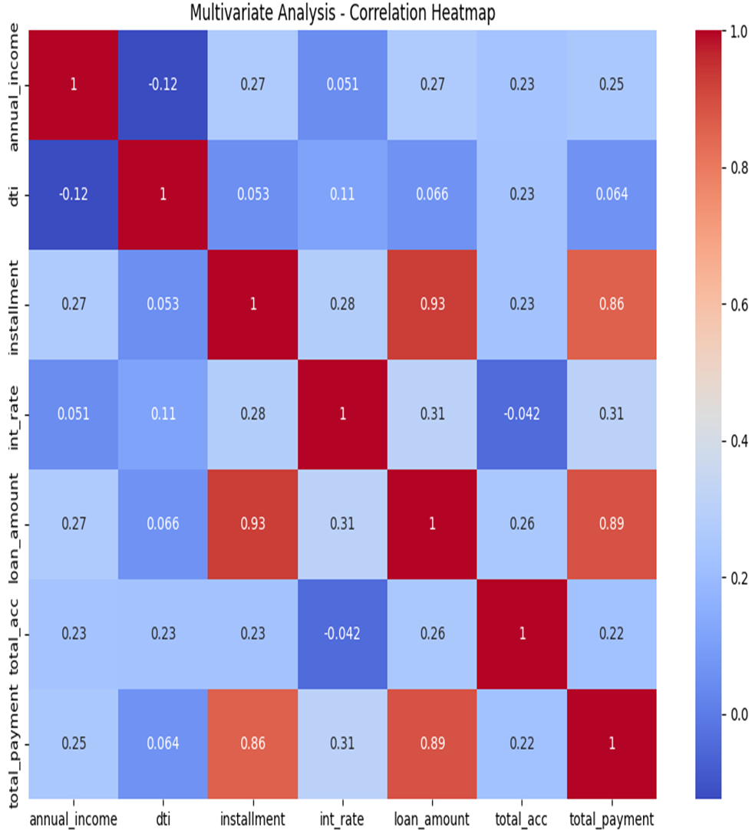

Slide 19
Data Preprocessing for Model Building
The following steps were done for preprocessing:
Encoding the categorical variables using one-hot encoding (using pd.get_dummies)
Treating outliers by capping the outliers using upper whisker and lower-whisker values (IQR method)
Using Standard Scaler to scale the numerical columns
After all the preprocessing steps, our dataset’s shape changed from (38576,16) to (38576,92) owing to encoding.
Target variable is encoded as 0 – Bad Loan, 1 – Good Loan.

Slide 20
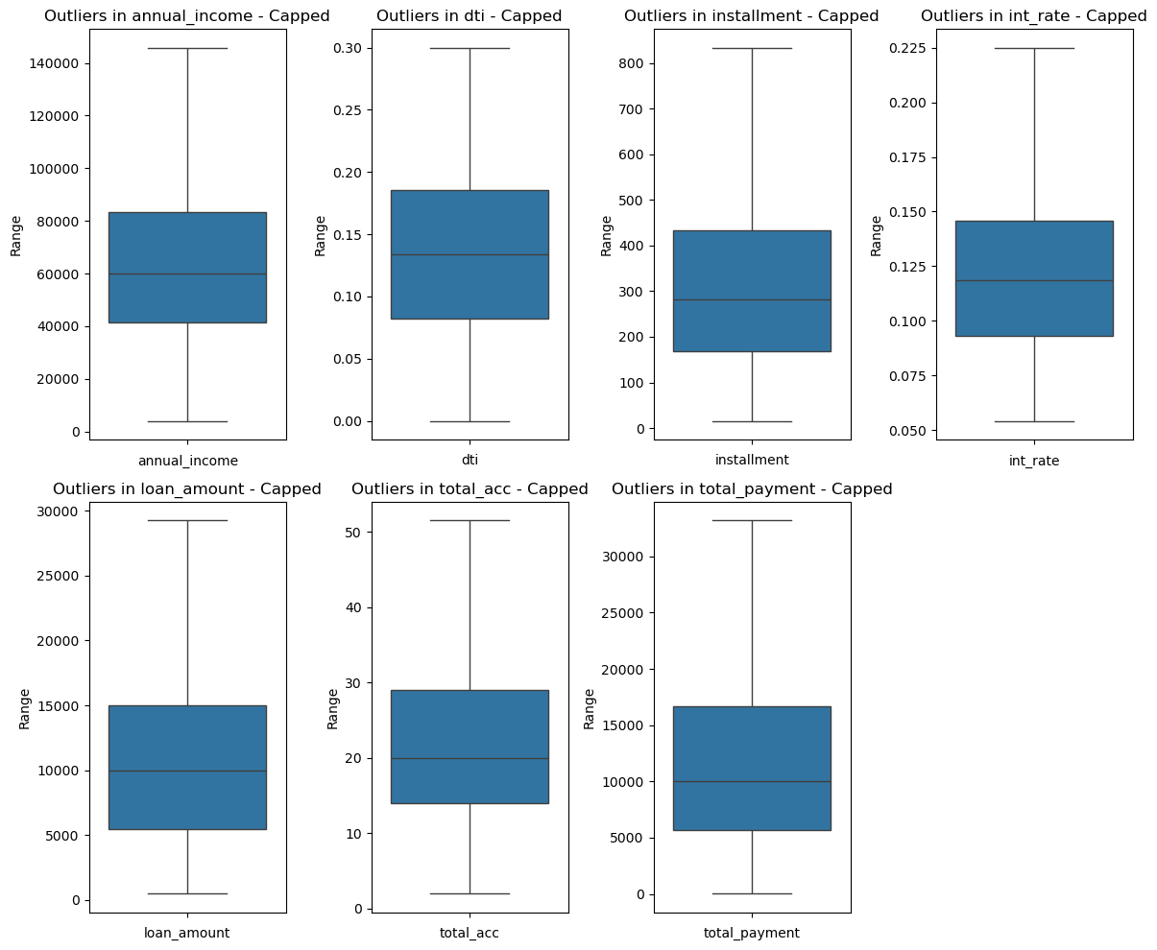
Outlier Capping
After
Before

Slide 21
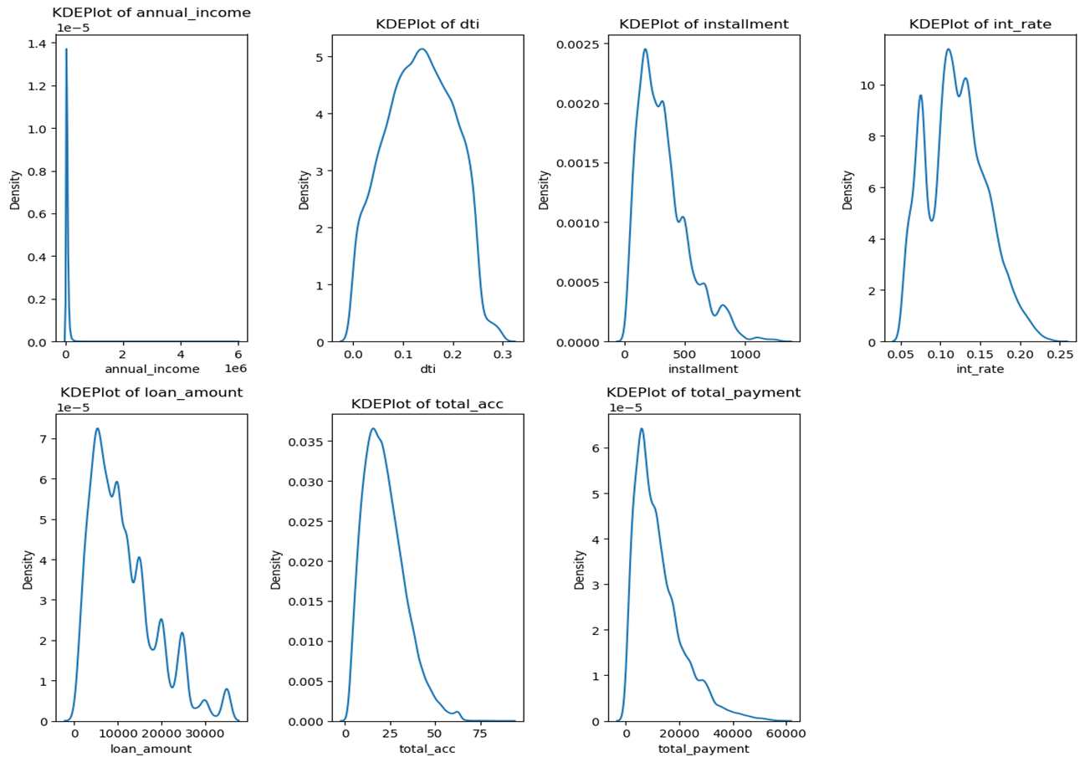
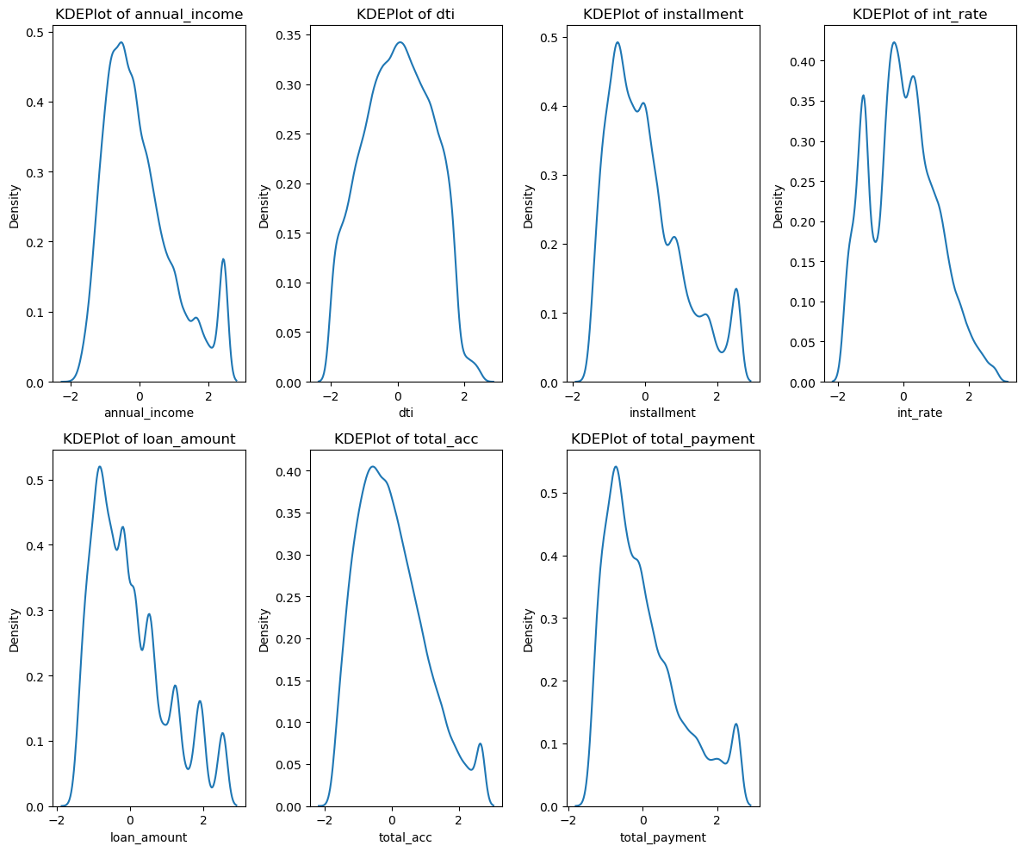
Skewness – Handled by Scaling
After
Before

Slide 22
Model Building
Given our problem is a binary classification problem, we chose Logistic Regression as our Base Model.
Ratio of train-test split: 80:20
Models built:
Logistic Regression
Decision Tree
Random Forest
Support Vector Machine (Classifier)
Boosting models
We also performed Recursive Feature Elimination after our base model and derived 45 features which were ranked at the highest importance. Being able to build a model with lesser number of features is always preferred, so we compared the efficiencies and metrics of the models built with all features vs the features chosen by our RFE.

Slide 23
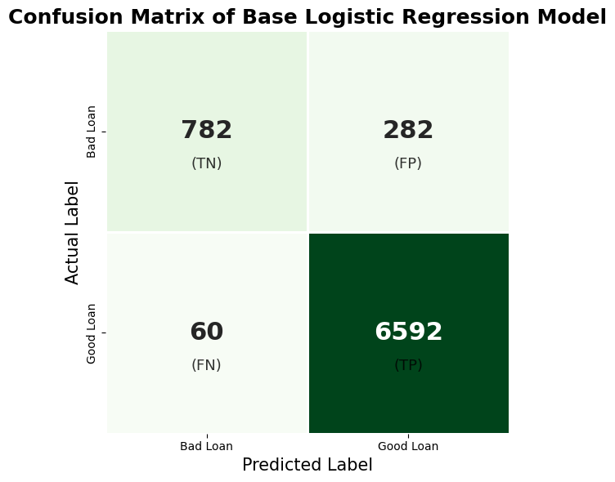
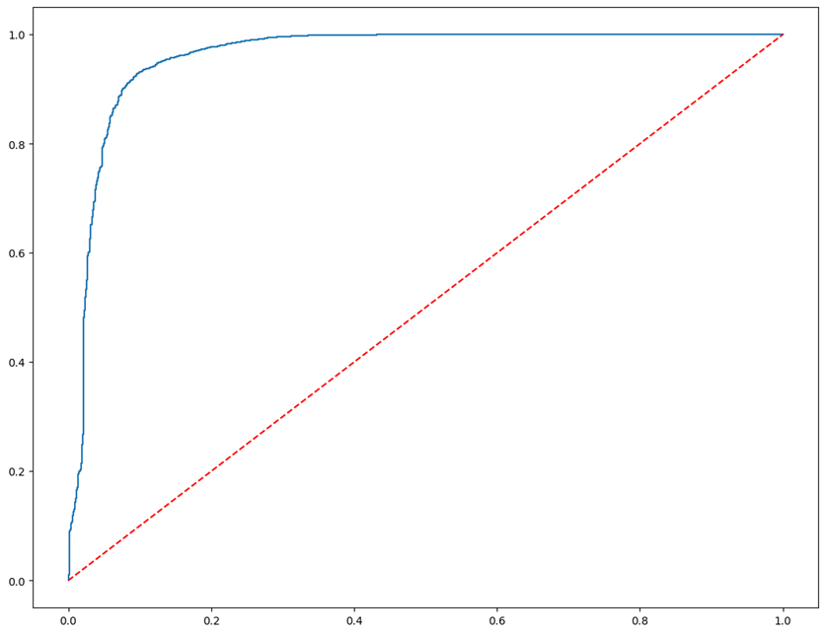
Base Model – Logistic Regression
AUC Score: 0.9610

Slide 24
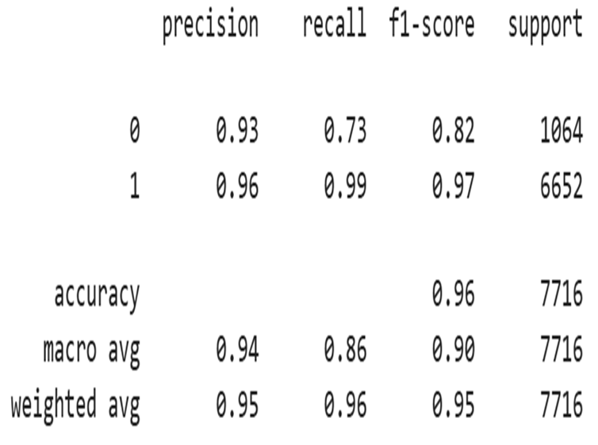
Base Model – Logistic Regression
Overall insights:
High model accuracy of 0.96
Precision for both classes are high
Recall value for the 0 class – Bad Loan – is low
ROC-AUC Curve and score are high values
The weighted average of f1-score is good
This model uses all 91 features

Slide 25
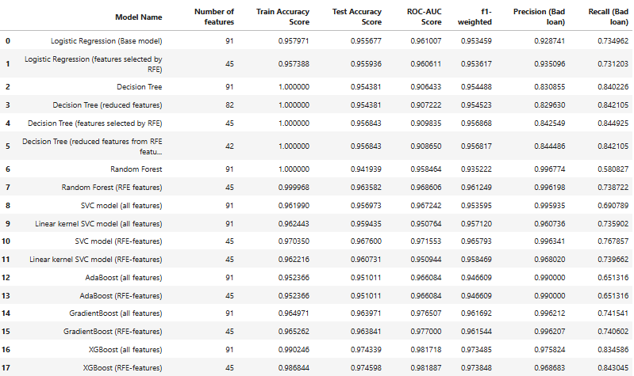
A Summary of All Models Considered

Slide 26
Final Model – XGBoost with RFE-selected features
We finalized on our final model based on certain criteria:
Minimal difference between training accuracy and test accuracy
Number of features used by the model
Precision and Recall scores of the ‘Bad Loan’ 0 class

Slide 27
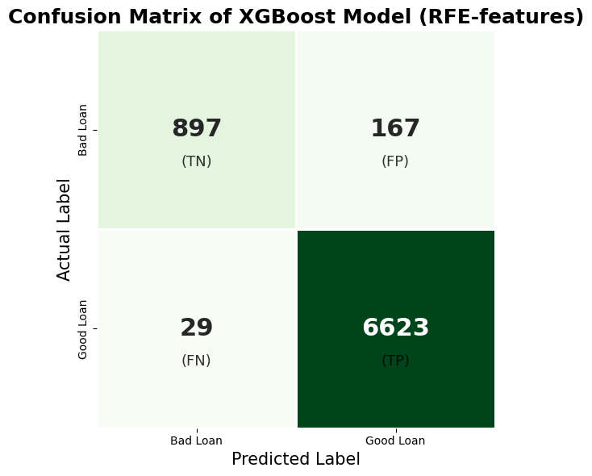
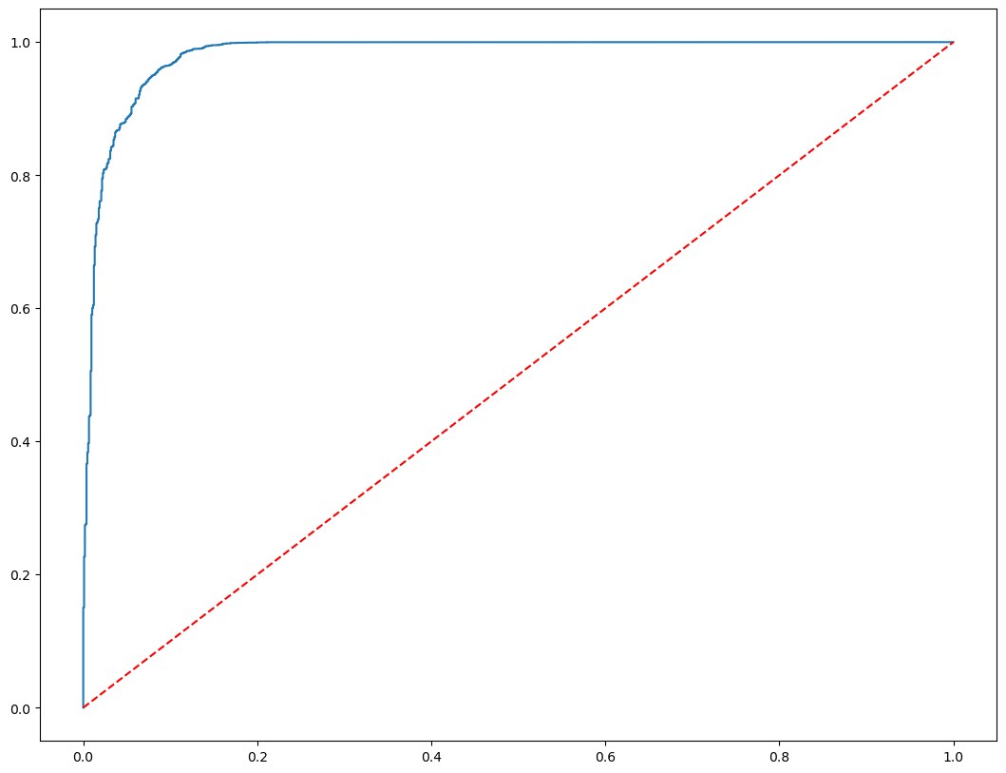
Detailed Metrics of the Final Model
AUC Score: 0.9818

Slide 28
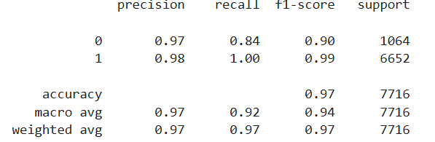
Final Model – Classification Report
Overall insights:
High model accuracy of 0.97
Precision for both classes are high
Recall value for the 0 class – Bad Loan – is much higher than all models
ROC-AUC Curve and score are high values
The weighted average of f1-score is good
This model uses less number of features (45 RFE-selected columns)

Slide 29
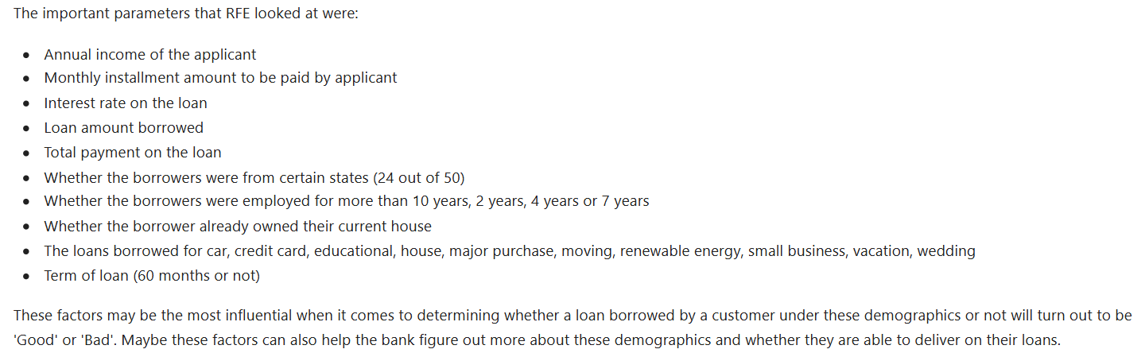
Conclusion
Evaluation metrics: Train accuracy, test accuracy, f1-weighted, ROC-AUC score, Precision and Recall for the Bad Loan class
Train and test accuracies of all models were high, but when it came down to choosing the best model, the difference between them, the precision and recall scores of the Bad Loan class, and the number of features used played a vital role in our decision

